Slide 1
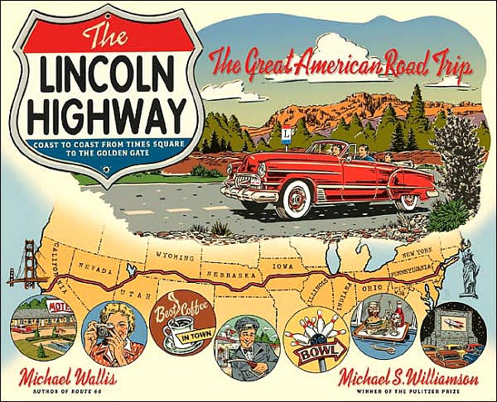
Lincoln Highway – United States of America

Slide 2
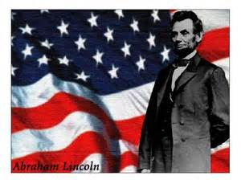
16th President of the united states In office: March 4, 1861 – April 15, 1865

Slide 3
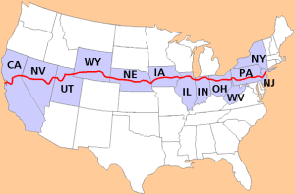
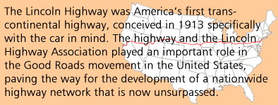

Slide 4
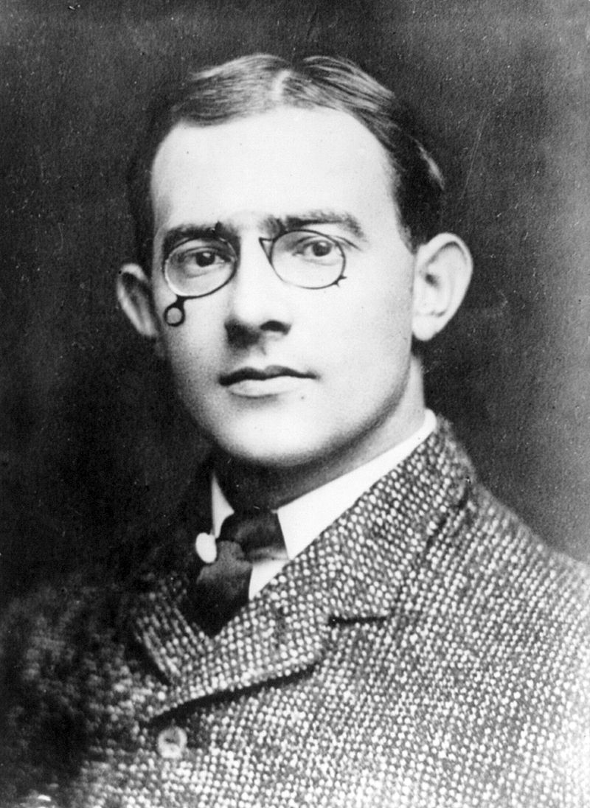
In 1912, Carl G. Fisher conceived and helped develop the Lincoln Highway.

Slide 5
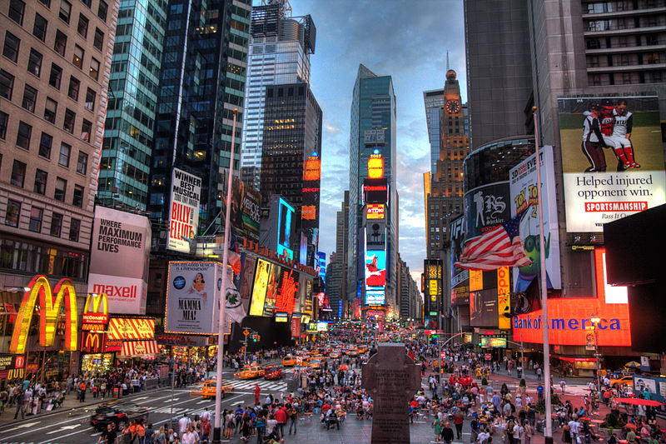
Times Square – New York City, New York Where our journey from New York City NY to San Francisco CA begins.

Slide 6
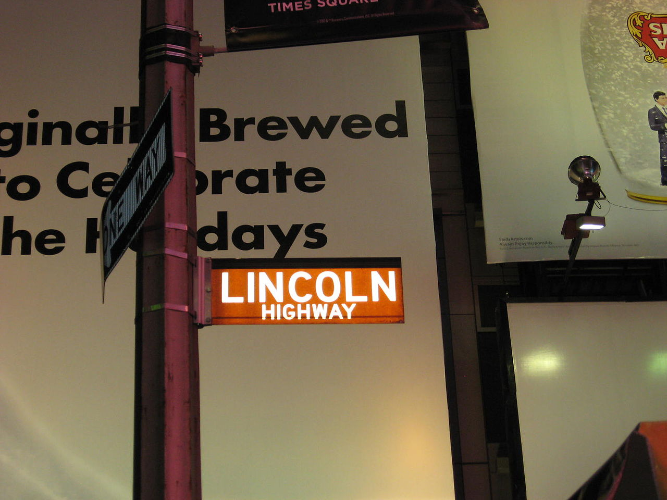
Lincoln Highway Eastern Terminus New York City, New York

Slide 7
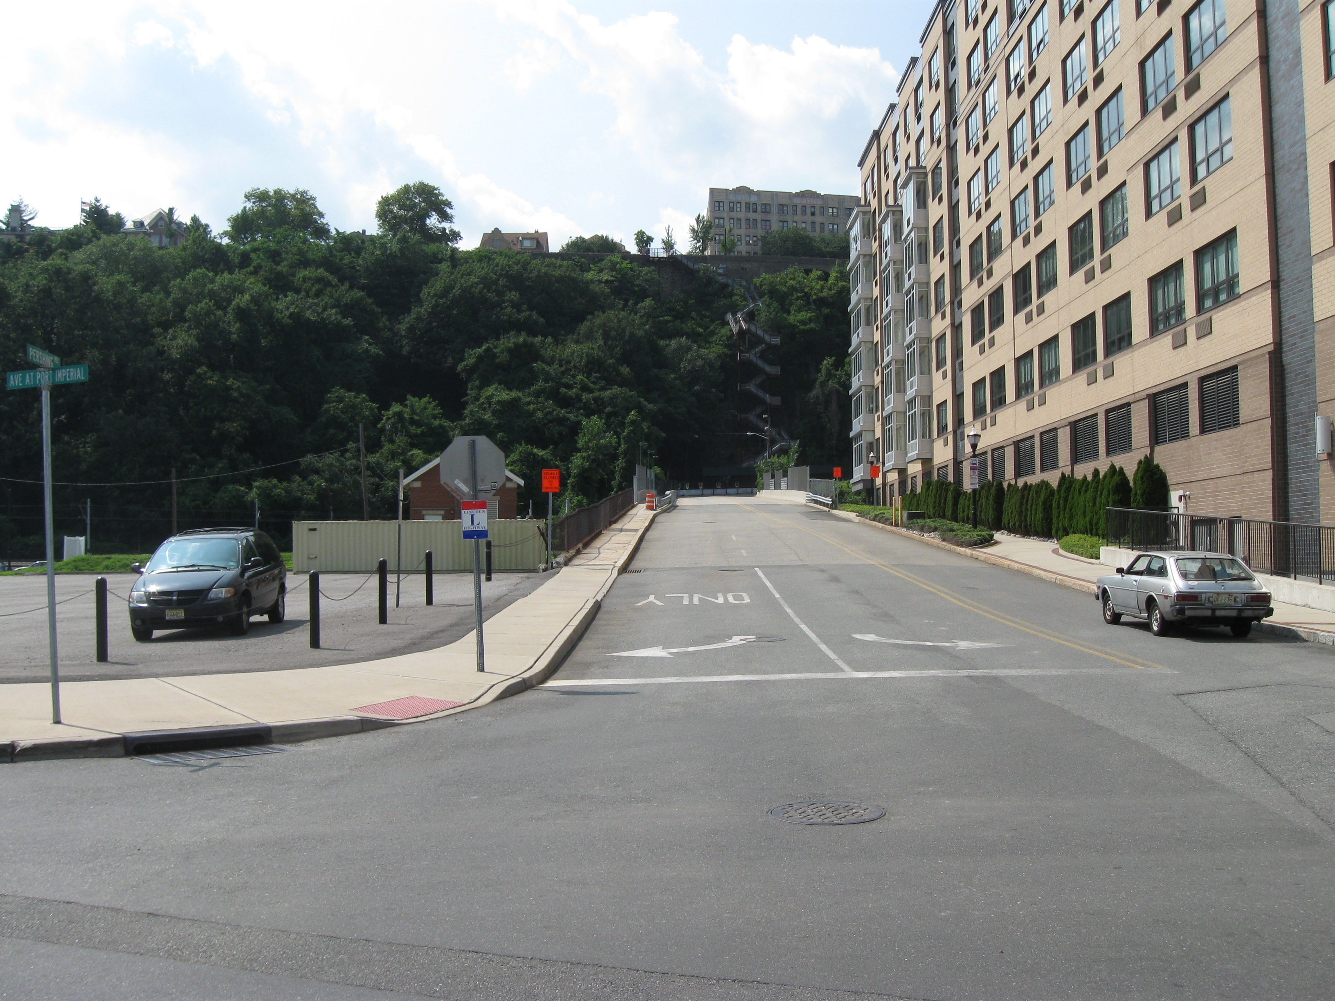
Pershing Road Waukegan, New Jersey

Slide 8
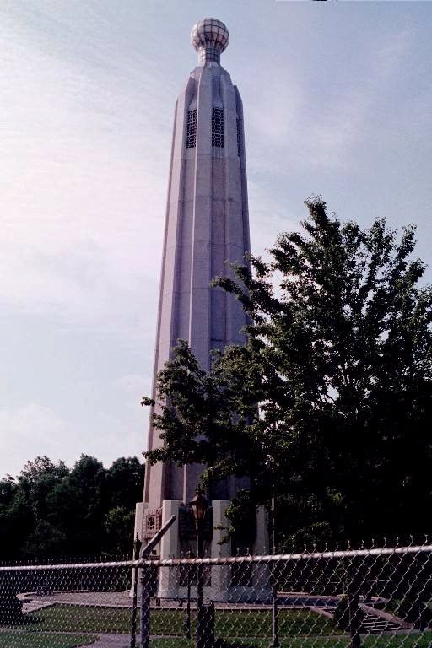
Thomas Edison Monument Edison, New Jersey

Slide 9
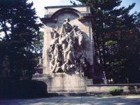
Princeton Battle Monument Princeton, New Jersey

Slide 10
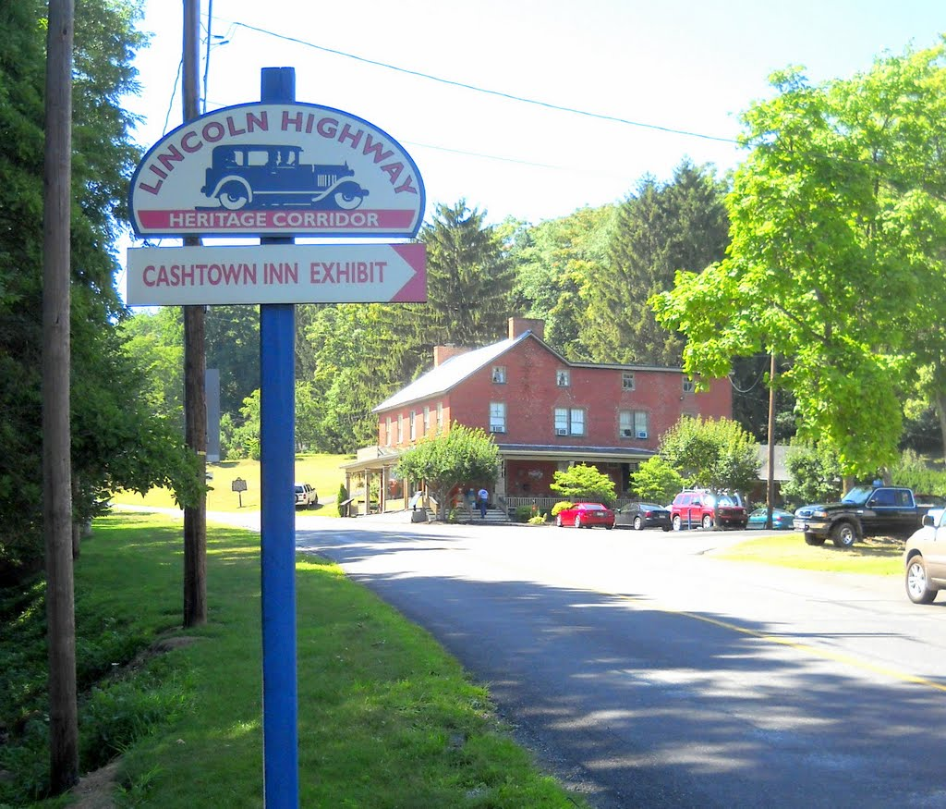
Lincoln Highway Cash town, Pennsylvania

Slide 11
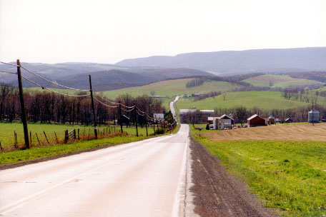
SChellsburg, Pennsylvania

Slide 12
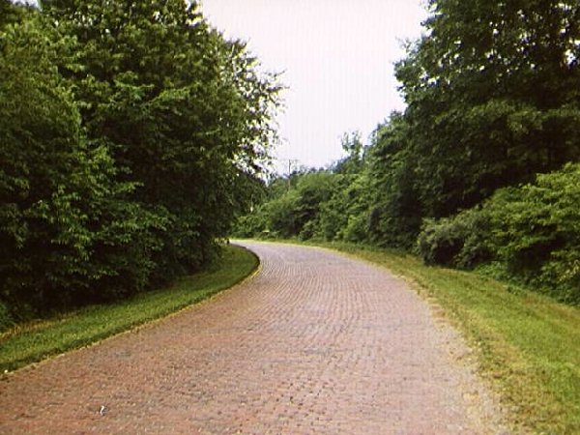
Lincoln Highway Canton, Ohio

Slide 13
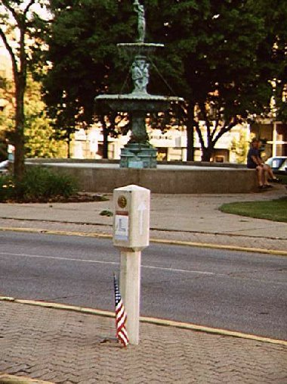
Lincoln Hwy Marker Mansfield, Ohio

Slide 14
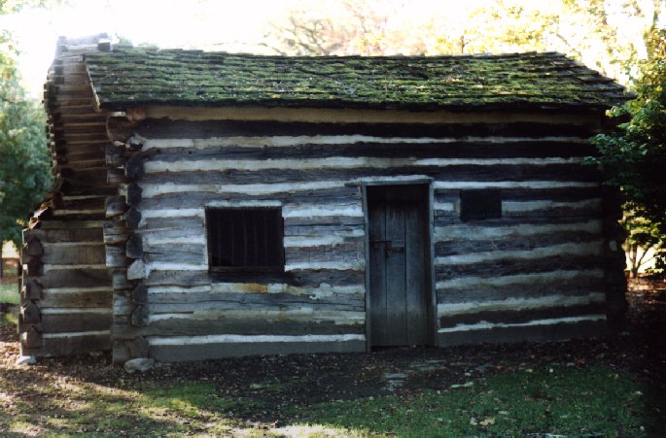
Log Cabin Fort Wayne, Indiana

Slide 15
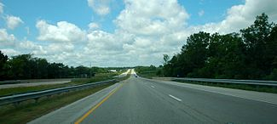
US 30 Westbound Indiana

Slide 16
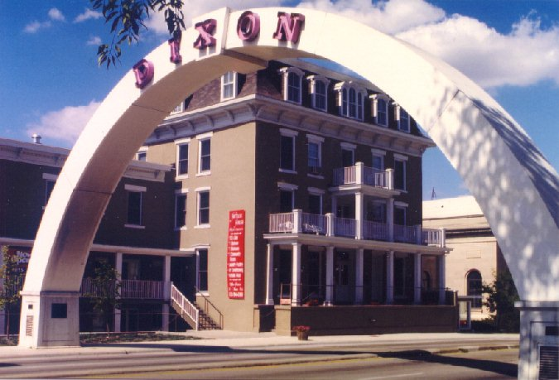
Dixon Arch Spanning Lincoln Highway Dixon, Illinois

Slide 17
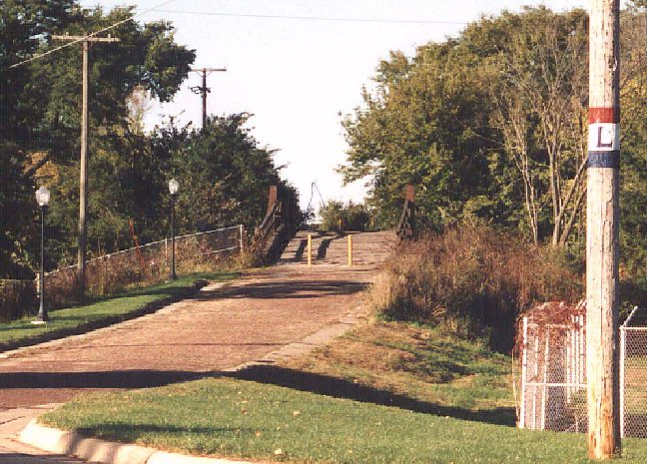
Lincoln Highway Mount Vernon, Illinois

Slide 18
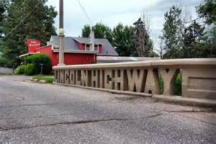
Tama, Iowa

Slide 19
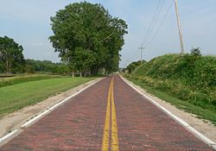
Near Elkhorn, Nebraska

Slide 20
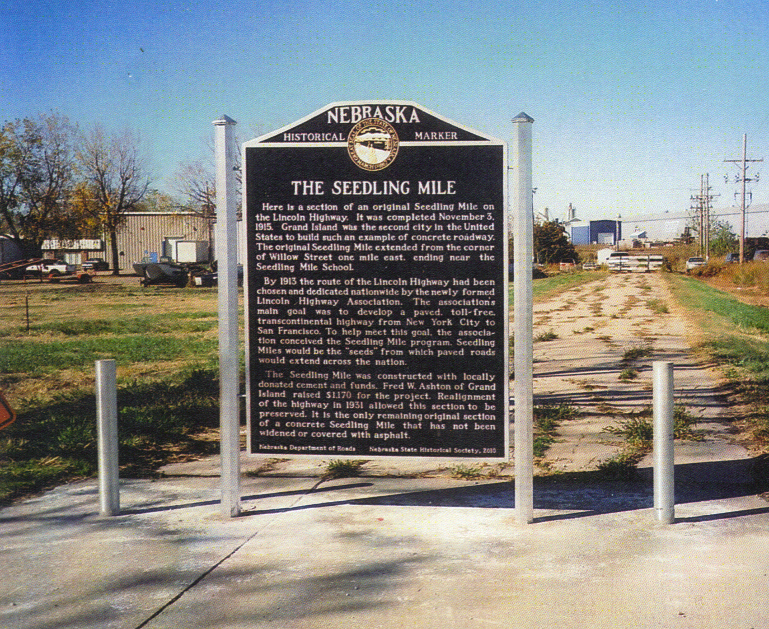
Monument Marker Grand Island, Nebraska

Slide 21
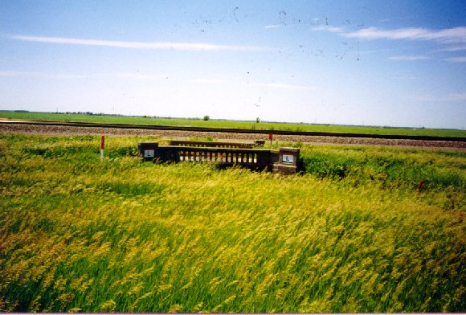
Overton Bridge Overton, Nebraska

Slide 22
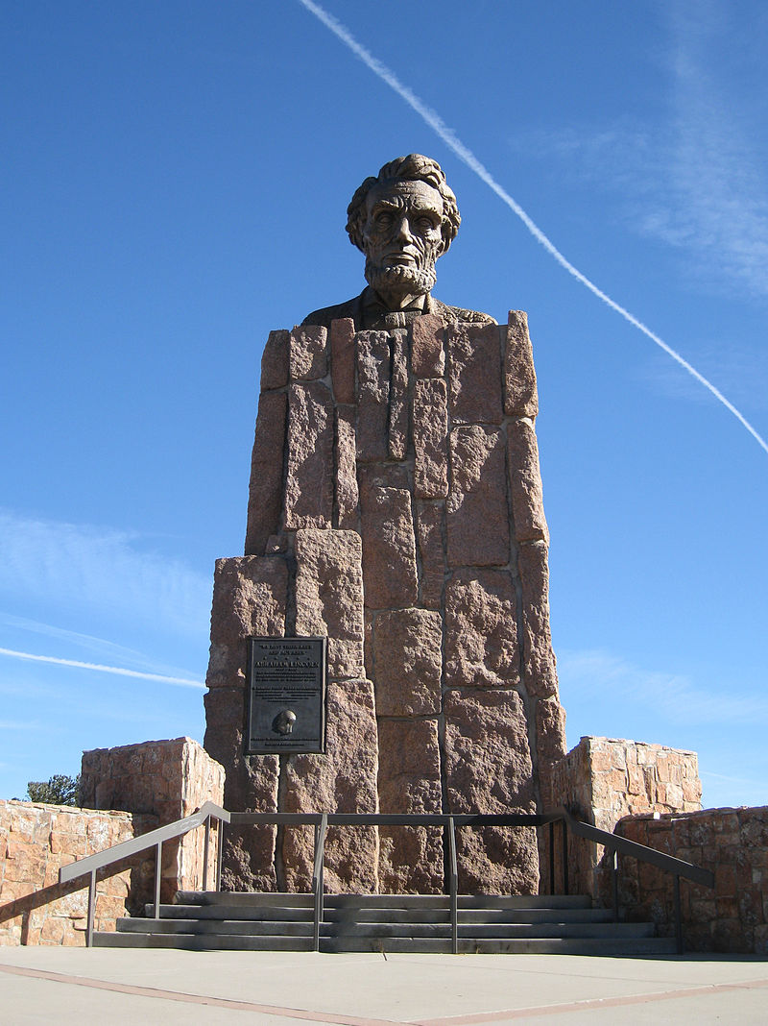
Lincoln Monument Wyoming

Slide 23
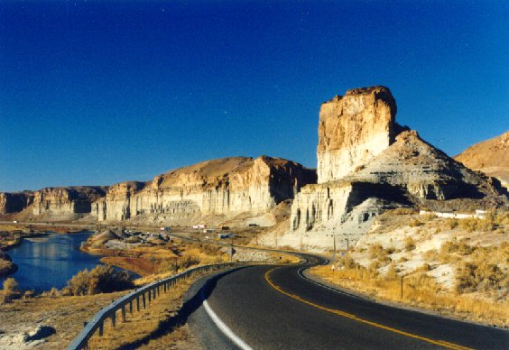
Green River, Wyoming

Slide 24
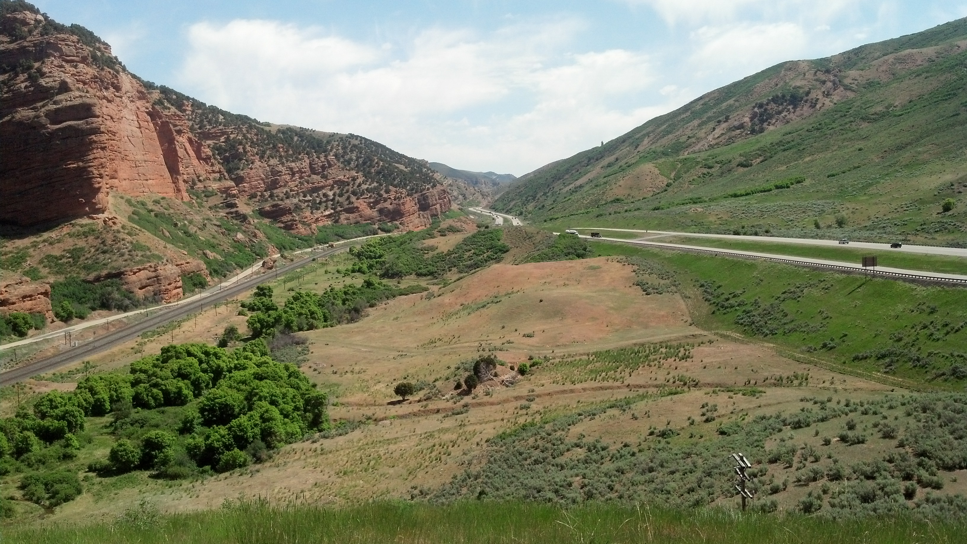
Echo Canyon, Utah

Slide 25
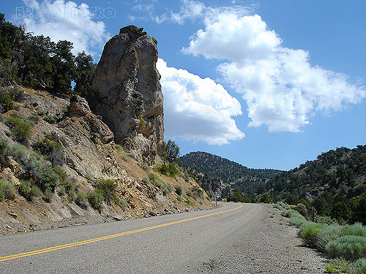
Lincoln Highway Nevada

Slide 26
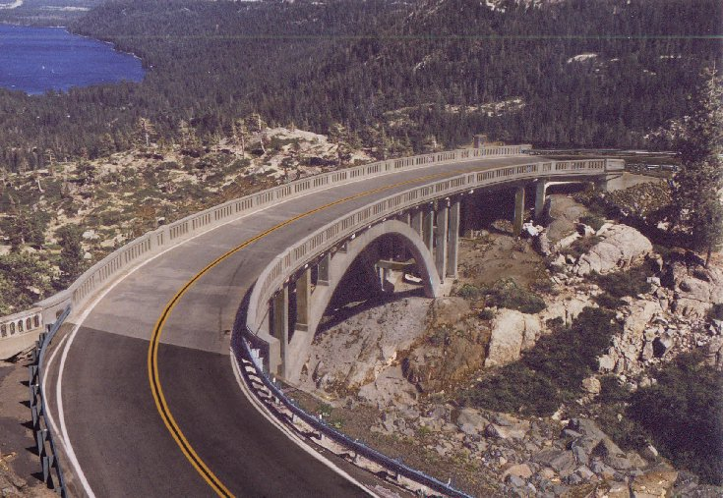
Rainbow Bridge Donner Pass - California

Slide 27
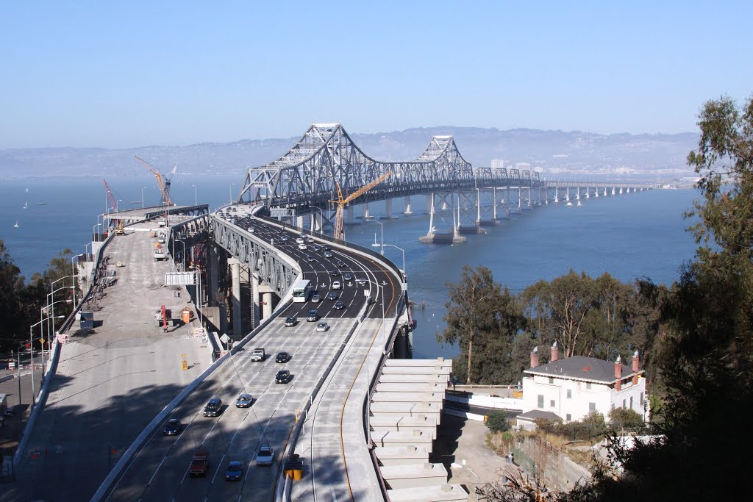
Oakland Bay Bridge Oakland, California to San Francisco, California
Carl_G_Fisher_1909

Slide 28
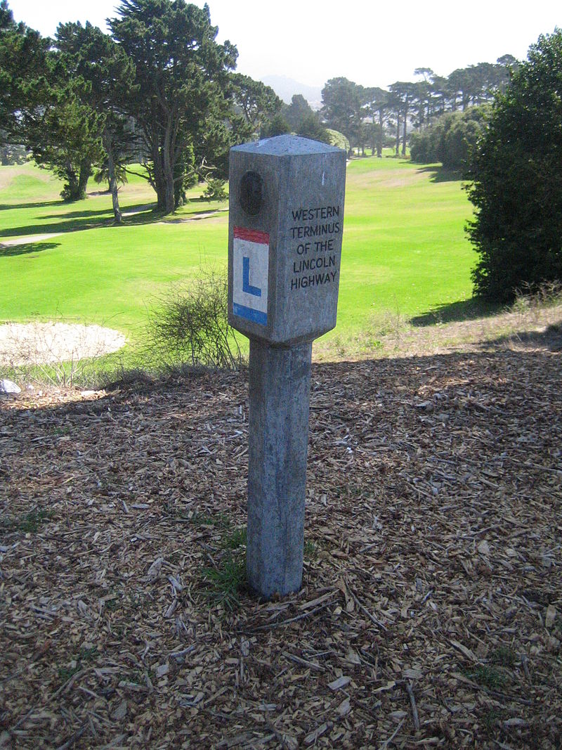
Lincoln highway western terminus marker Lincoln park – san Francisco, California

Slide 29
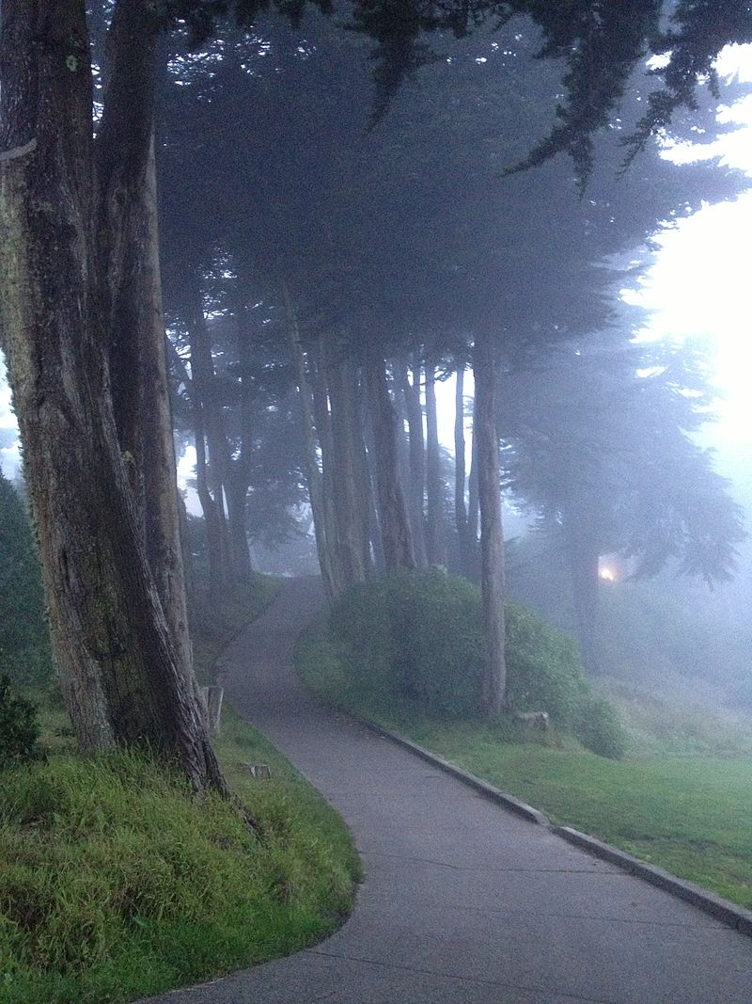
Lincoln park – san Francisco, California

Slide 30
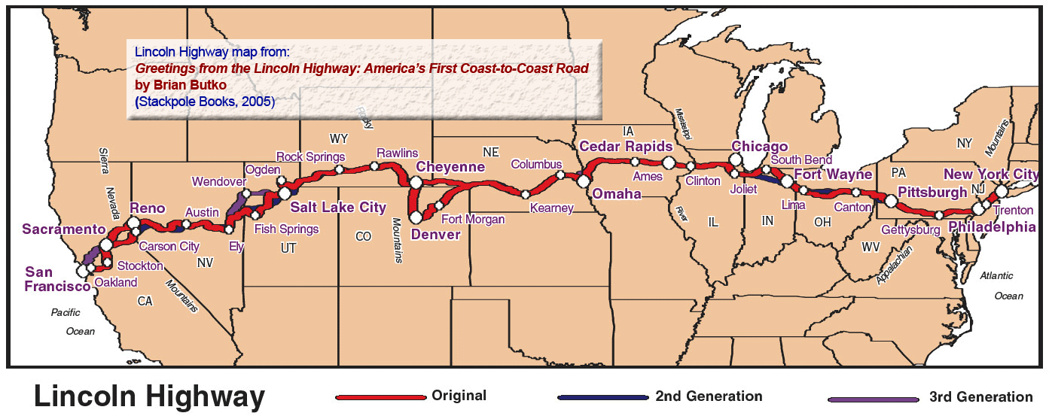
Lincoln highway coast to coast

